Slide 1
Classification of Discrete Time Signals lecture 3

Slide 2
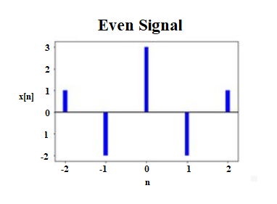

Even and Odd signal
A signal is said to be an even signal if it is symmetrical about the vertical axis or time origin, i.e.,
x(-t)=x(t) for all t, … continuous time signal
x[-n]=x[n] for all n, … discrete time signal

Slide 3
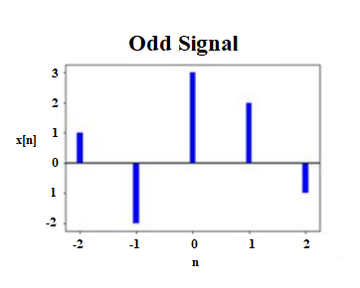
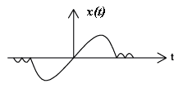
Even and Odd signal
A signal is said to be an odd signal if it is anti-symmetrical about the vertical axis or time origin, i.e.,
x(-t)=-x(t) for all t, … continuous time signal
x[n]=-x[n] for all n, … discrete time signal

Slide 4
Even and Odd signal
An important fact is that any signal can be broken into a sum of two signals, one of which is even and one of which is odd.

Slide 5
Even and Odd signal
Let x(n) be an arbitrary signal. Let x(n) be expressed as the sum of two components x_{e}(n) and x_{o}(n) as follows:
x(n)= x_{e}(n)+ x_{o}(n)
x_{e}(-n)= x_{e}(n) and x_{o}(-n)=- x_{o}(n)
Putting t=-t in the expression for x(t), we may write,
x(-n)= x_{e}(-n)+ x_{o}(-n)= x_{e}(n)- x_{o}(n)
Solving for x_{e}(t) and x_{o}(t), we thus obtain
x_{e}(n)=1/2[x(n)+x(-n)] and x_{o}(n)=1/2[x(n)-x(-n)]

Slide 6
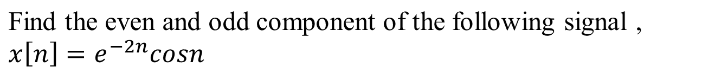
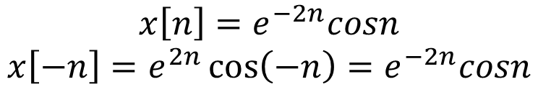
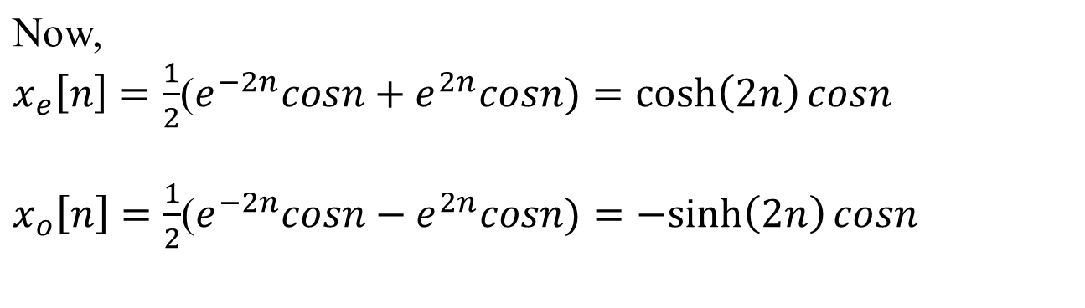
Example
Solution:
sinh(x) = (exp(x) - exp(- x)) / 2, cosh(x) = (exp(x) + exp(- x)) / 2

Slide 7
Even and Odd signal
When the even part of the signal is zero, that is x_{e}(n)=0, then we call the signal odd signal.
When the odd part of the signal is zero, that is x_{o}(n)=0, then we call the signal even signal.

Slide 8






Example
Find the even and odd components of the discrete-time signal x(n), where,
Solution:
The given discrete time sequence is,
Here,

Slide 9
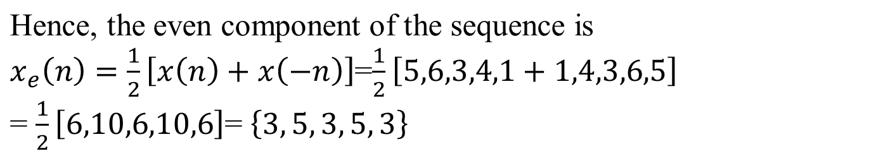

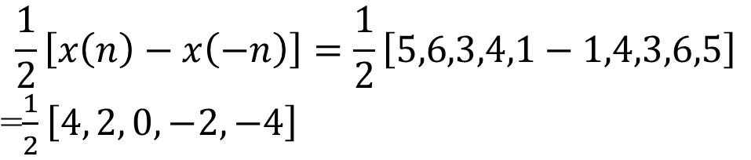



Example
Solution:
And the odd component of the sequence is,

Slide 10

Find the even and odd components of each of the following signals

Slide 11
Periodic signals and non-periodic signals
A periodic signal is one that repeats itself in time. Mathematically,
x(t)=x(t+T) for all t,
where T is a positive constant
If this condition is satisfied for T=T₀ (say) then it also satisfied for T=2T₀, 3T₀, 4T₀, 5T₀,……The smallest value of T that satisfy the above equation is called fundamental period of x(t).

Slide 12
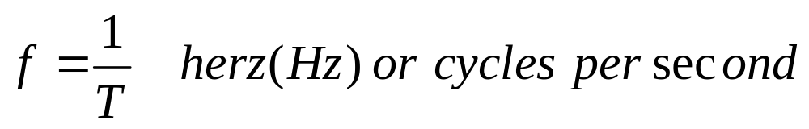
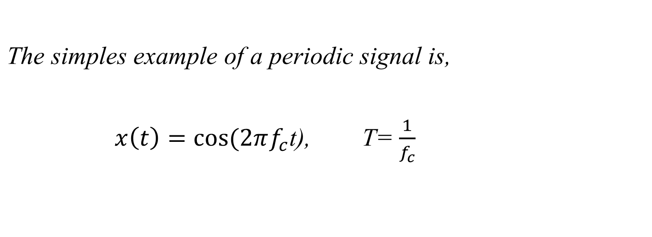
Periodic signals and non-periodic signals
The reciprocal of the fundamental period T is called the fundamental frequency of the periodic signal x(t).

Slide 13
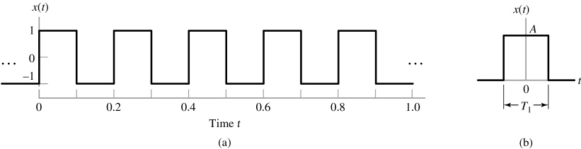
Periodic signals and non-periodic signals
Any signals x(t) for which no value of T satisfies the condition is called an aperiodic or nonperiodic signal
Figure
(a) Square wave (periodic) with amplitude A = 1 and period T = 0.2s.
(b) Rectangular pulse (non-periodic) of amplitude A and duration T₁.

Slide 14
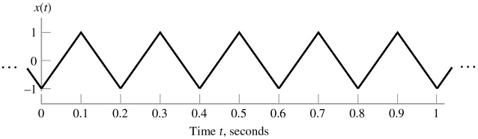
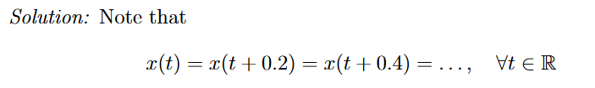
Example
Figure below shows a triangular wave. What is the fundamental frequency of this wave? Express the fundamental frequency in units of Hz and rad/sec.

Slide 15
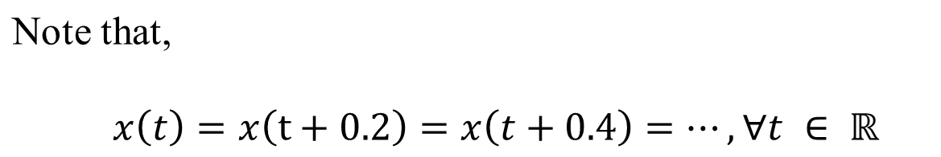
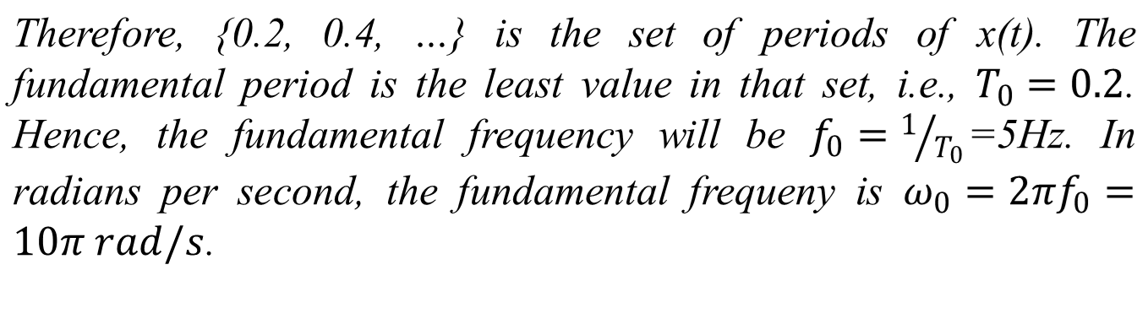
Solution

Slide 16
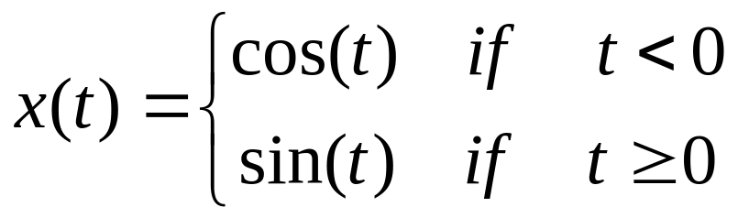
Example
Identify whether the following signal is periodic or non-periodic.
Solution
From the graph of cos and sin, we can infer that at t=0, the function becomes discontinuous. Since, cos0=1, but sin0=0. Hence the function x(t) is Non-periodic.

Slide 17
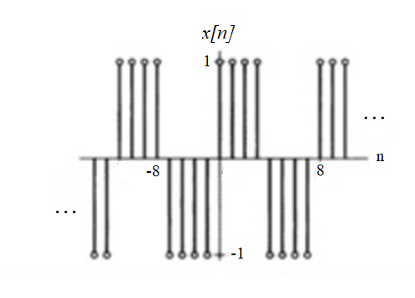
Example
Determine the fundamental frequency of the discrete-time square wave shown in Figure below.

Slide 18
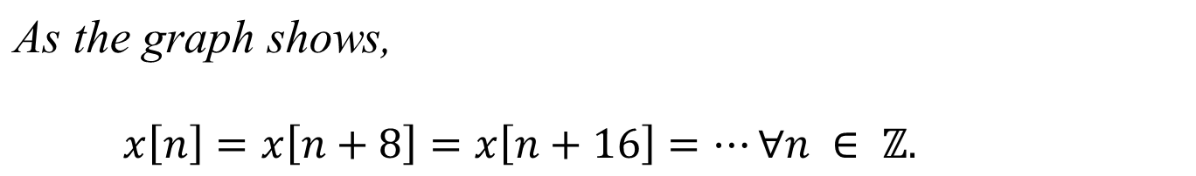
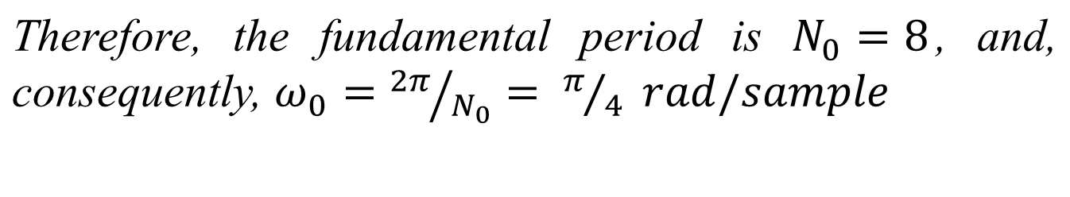
Example
(Set of Integers)

Slide 19
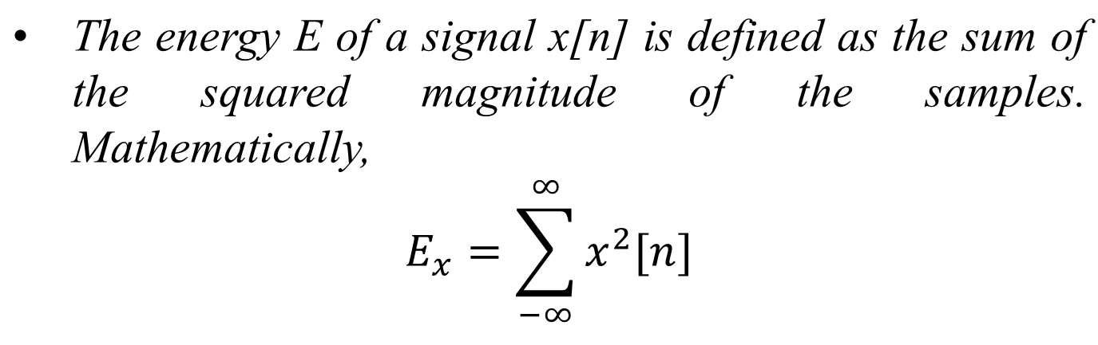
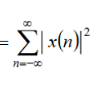
Energy and Power Signal
A signal is referred to as an energy signal if and only if the total energy of the signal satisfies the condition
0<E<∞

Slide 20
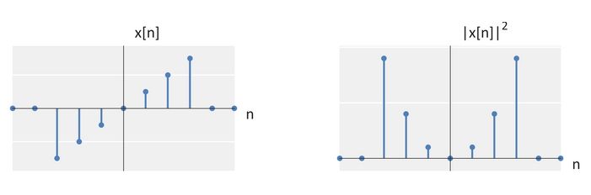
Energy and Power Signal
Physical Interpretation
Discrete-time signal
Square of discrete-time signal. Summing this signal gives the energy

Slide 21
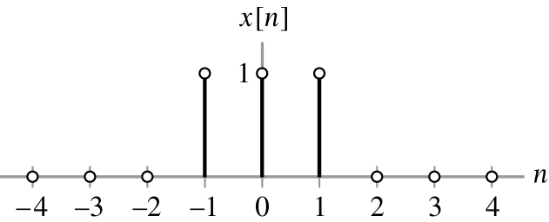
Energy and Power Signal
Problem
What is the total energy of the rectangular pulse shown below:
Ans: 3

Slide 22
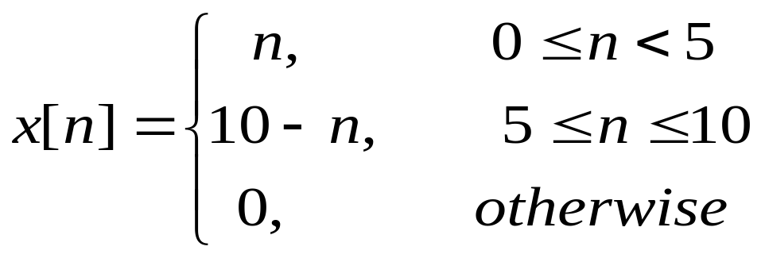
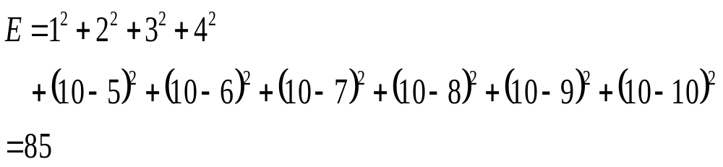
Energy and Power Signal
Problem
What is the total energy of the rectangular pulse shown below:
Ans:

Slide 23


Energy and Power Signal
The signal power of a discrete time signal x(n) is,
When the signal is periodic, the power simplifies to
Where N is a period of the periodic signal. This equivalent to saying that the power of a periodic signal is equal to the average energy in one period in the signal.

Slide 24
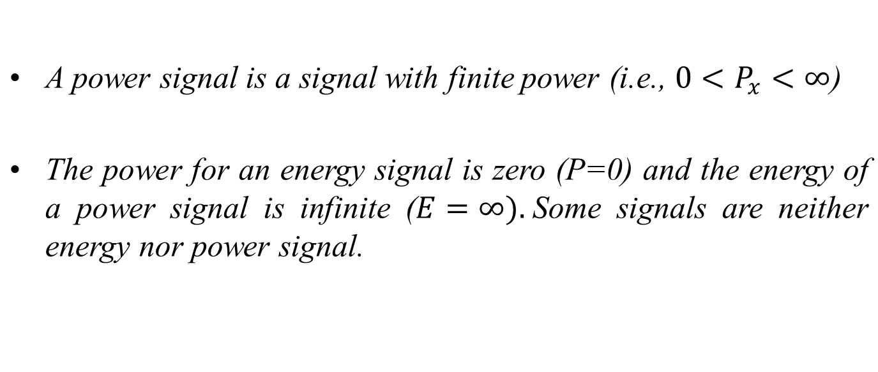
Energy and Power Signal

Slide 25
Energy and Power Signal
Every periodic signal is a power signal.
Every power signal need not be periodic.
Every energy signal is non-periodic
Every non-periodic signal need not be an energy signal.

Slide 26
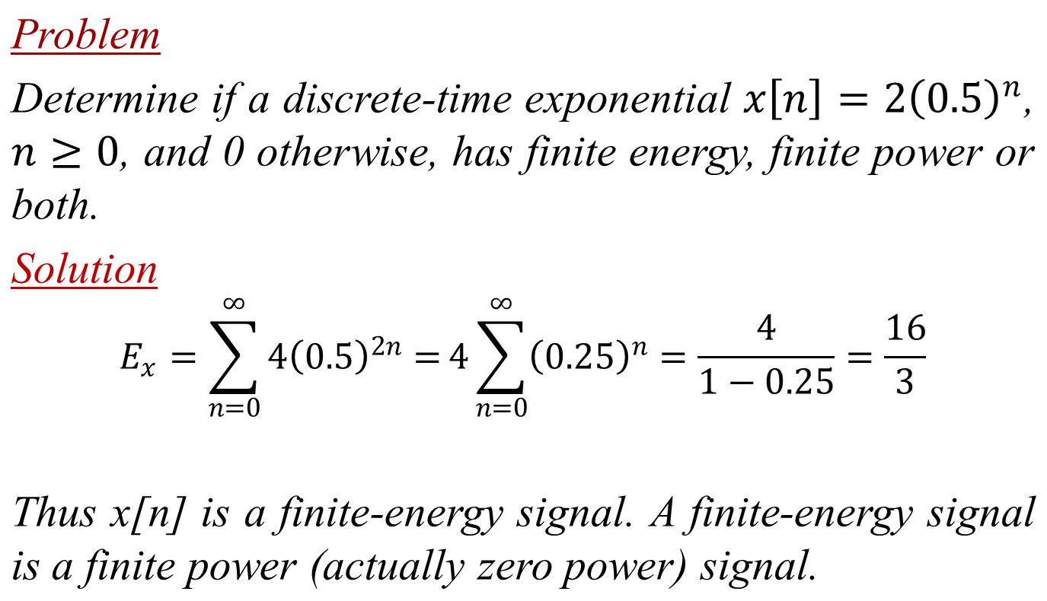
Energy and Power Signal

Slide 27
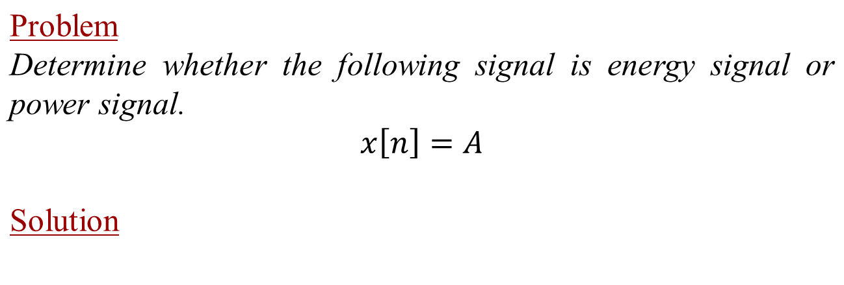
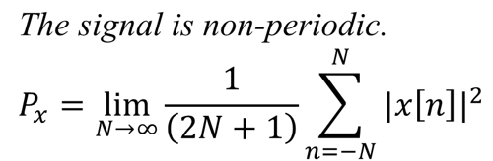
Energy and Power Signal

Slide 28
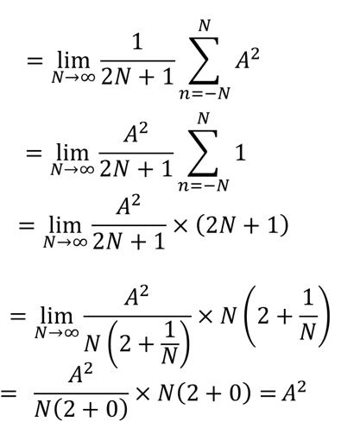
Energy and Power Signal

Slide 29
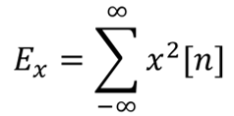
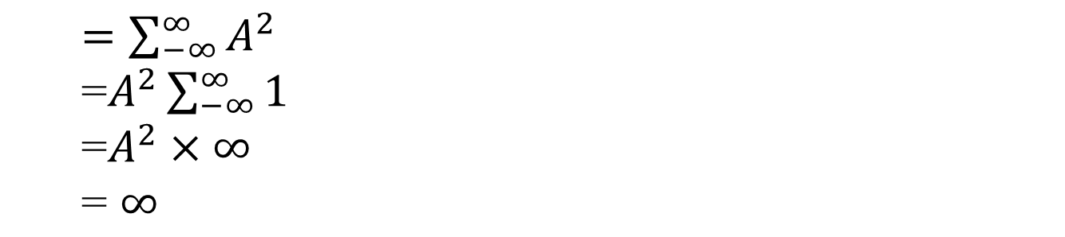
Energy and Power Signal

Slide 30
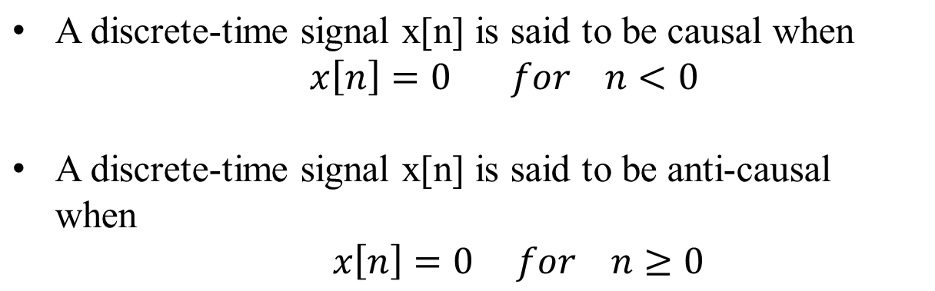
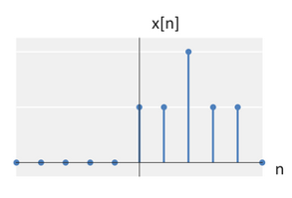
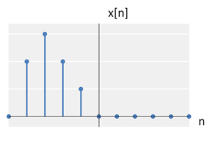
Causal and Acausal
Causal discrete-time signal
Anti-causal discrete-time signal

Slide 31
End

